Slide 1
CU6051NA Artificial Intelligence Weather Forecast with Unsupervised Learning
Prayash Bikram Shah
16033180

Slide 2
Topics
Introduction and AI concept Used
Research evidences
Why this topic?
Solution and Development
Achieved Results
Pseudocode of the solution
Diagrammatical representations

Slide 3
Introduction and AI concepts used
Machine Learning
part of Artificial Intelligence which trains data and analyze them to give an output.
Four categories Supervised and Unsupervised Learning, Reinforcement Learning and Deep Learning.

Slide 4
Introduction and AI concepts used
Unsupervised Learning
used when analyzing a sequence, data mining for sequence and pattern mining.
common method of this is cluster analysis
K means and agglomerative clustering.

Slide 5
Research evidences
AI Concepts
Machine Learning
Unsupervised Learning
Clustering

Slide 6
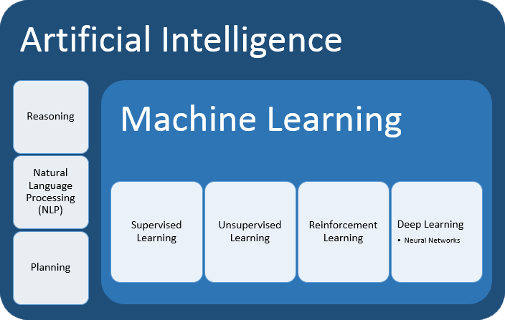
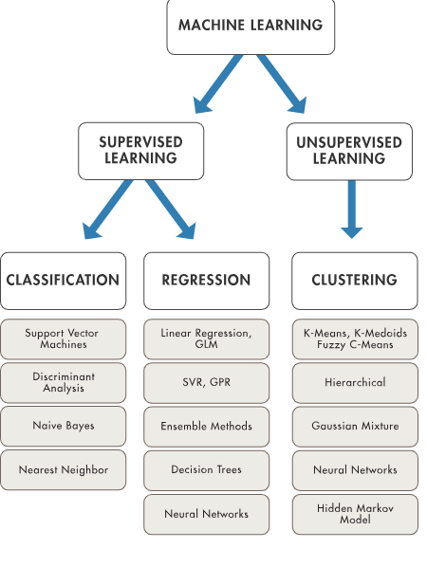
Research evidences

Slide 7
Why this topic?
Opportunity to learn about unsupervised learning.
Experiment of prediction using unsupervised learning.

Slide 8
solution and developed application
Weather Prediction using agglomerative clustering
Using dataset of Austin Weather
Data Filtering
Train Model/Split data into test and train sets
Predict events using the agglomerative clustering
Check Accuracy

Slide 9
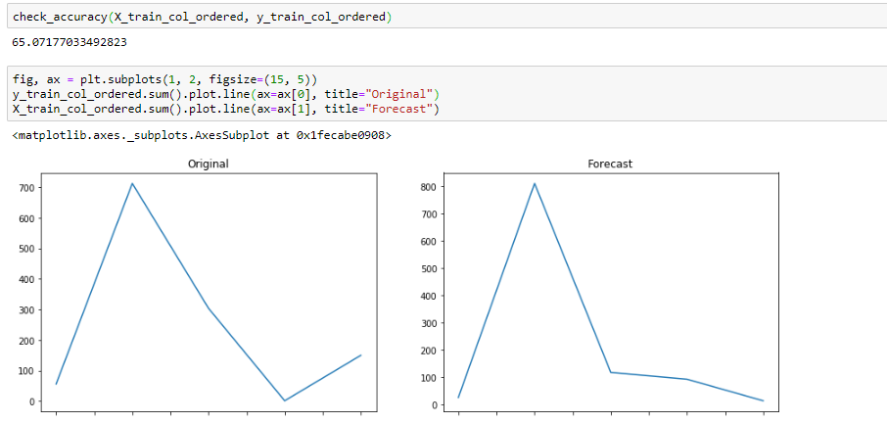
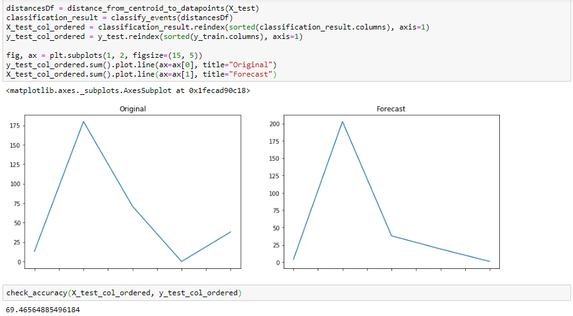
Achieved results

Slide 10
Pseudocode of the solution
import numpy library as np
import pandas library as pd
import matplotlib.pyplot library as plt
using sklearn.model_selection Scikit-learn library import train_test_split
using sklearn.cluster Scikit-learn library import Agglomerative Clustering
reading dataset weatherdata.csv
choosing specific columns from dataset
assigning chosen columns to data variable
function to find non-numeric data
Function to calculate the distance between centroids and data points
Adding tolerance so that we can classify the
Function to calculate accuracy
Displaying Accuracy of trained data
Predicting events using agglomerative algorithm
Displaying final accuracy of test data.
function to find row containing non-numeric data
assigning values to empty rows variable.
Function to replace values where T is there

Slide 11
Pseudocode of the solution
Classifying the events into different category
Dropping empty rows.
Converting the all the columns to numeric and describing it
Using Scikit-learn library import preprocessing
Normalize the input data
Splitting the data to train and test sets
Agglomerative Clustering and plotting the data
Mapping the cluster numbers to the categories.
Clusters center mapping
Function to calculate the distance between centroids and data points
Adding tolerance so that we can classify the
Function to calculate accuracy
Displaying Accuracy of trained data
Predicting events using agglomerative algorithm
Displaying final accuracy of test data.

Slide 12
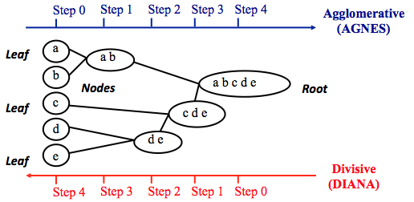
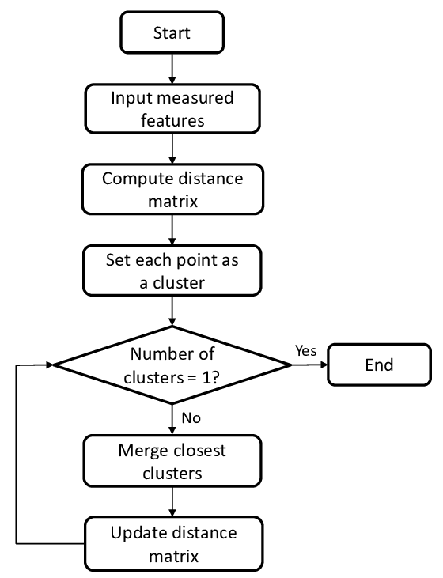
Diagrammatical representations

Slide 13
Thank You !

